Slide 1
INSTALLING A LICENSE KEY

Slide 2
SOMMAIRE
1
WHERE TO GO?
2
HOW DO I STOP THE INSTANCE SERVICE?
3
HOW DO I ACCESS THE LICENSE ORDER?
4
HOW DO I ASSIGN THE INSTANCES?
5
HOW DO I RESTART THE INSTANCE?

Slide 3
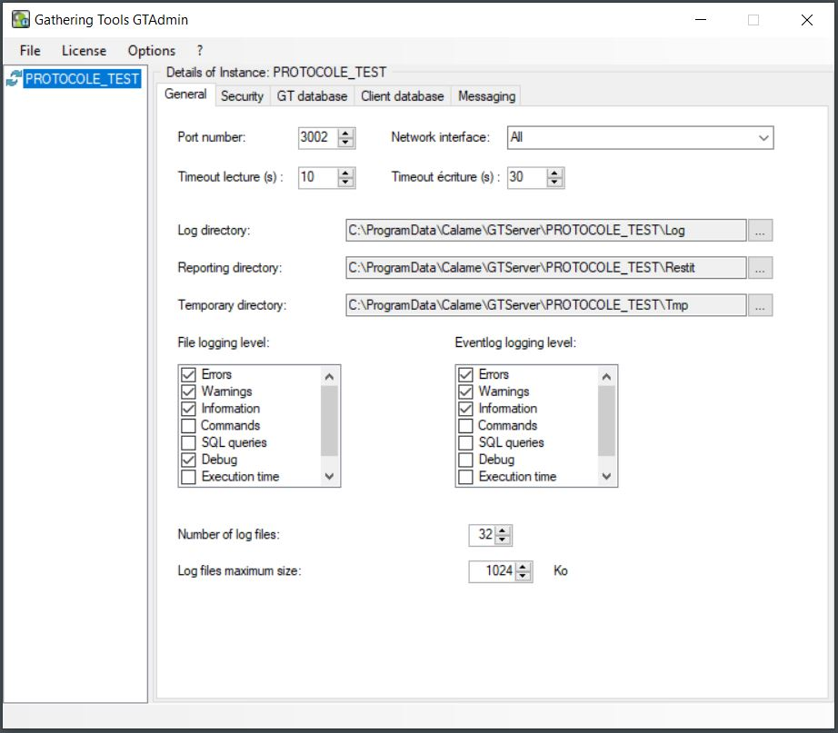
GO TO GTADMIN
Open GTAdmin
The instance is in service (recognizable by its 2 circular green arrows)

Slide 4
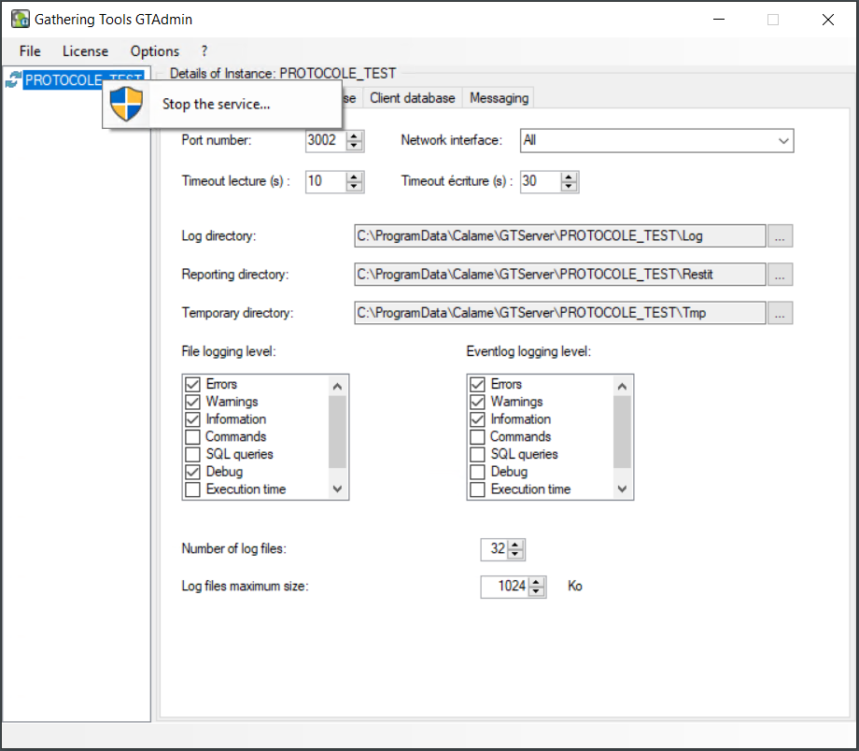
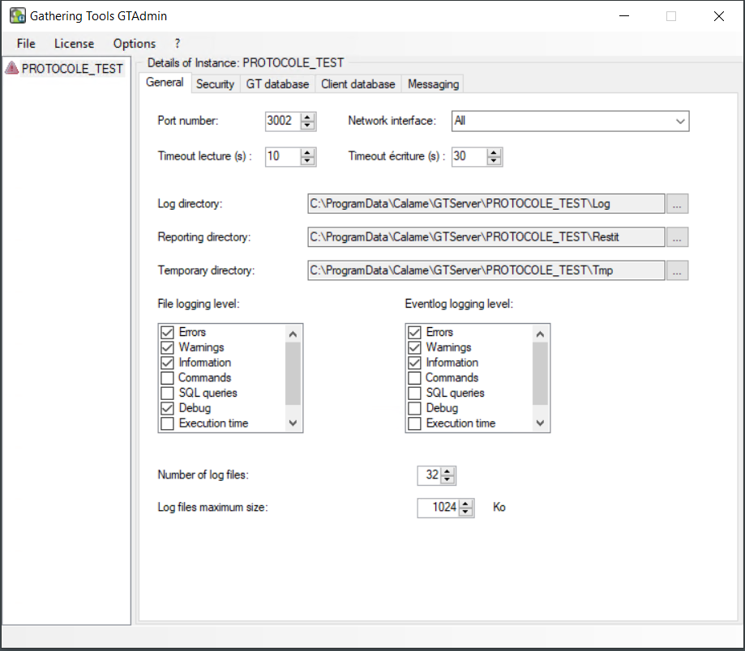
IN GTADMIN STOP THE INSTANCE SERVICE
Right-click Stop the service
on the instance
Arrows disappear to make way for a panel red
The instance is then stopped

Slide 5
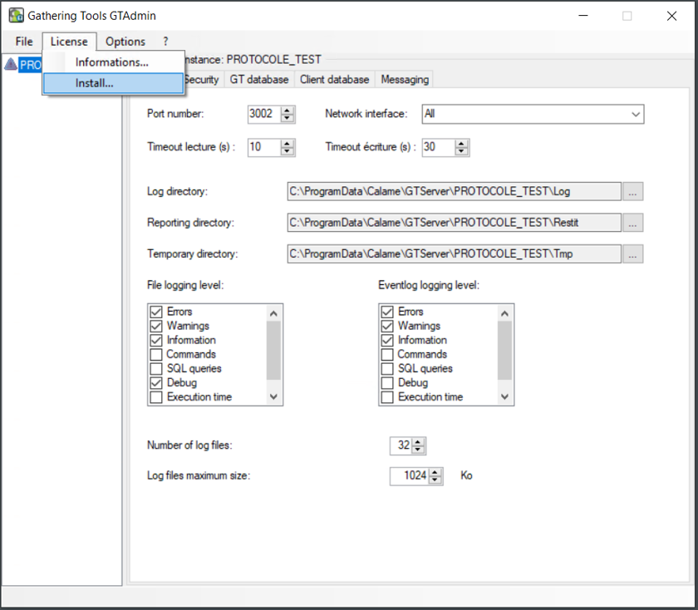
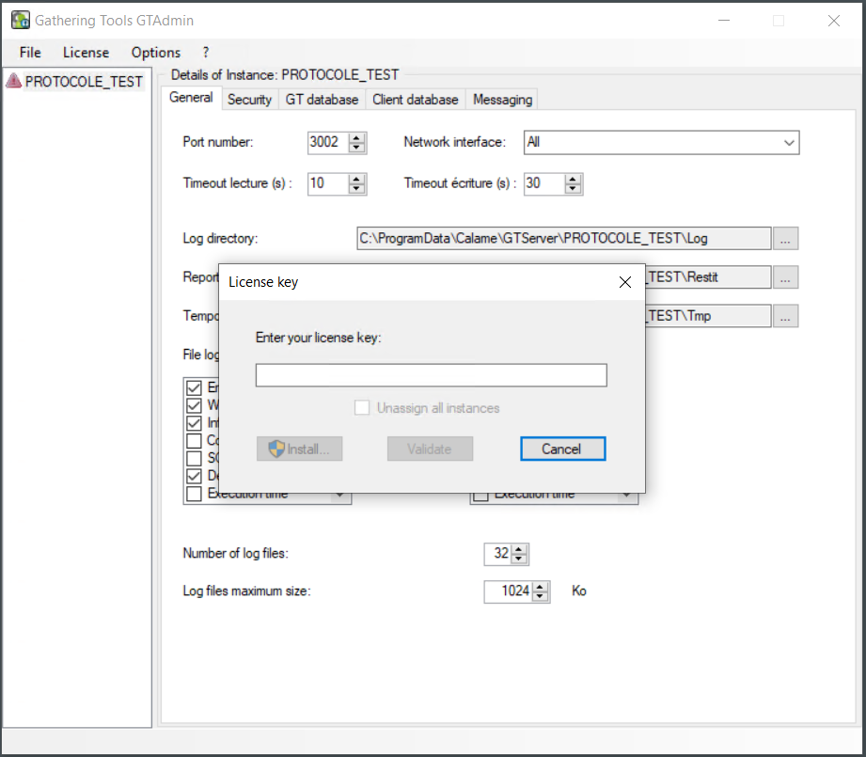
IN GTADMIN ACCESS THE LICENSE COMMAND
click on "Install"
A window appears

Slide 6
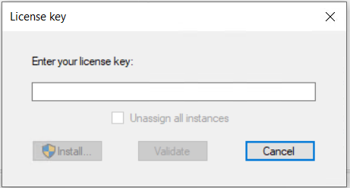
IN GTADMIN ACCESS THE LICENSE COMMAND
Support has sent you an installation key
In our demonstration :
CALAME-DEMONSTRATIONMB-28/09/2021-T- 01
Name of your company- instance- date of creation- type of key- number of the key
Yours will be in this format:
XXX-SERV1PROD1TEST1-28/09/2021-D-01
In the enter your window license key

Slide 7
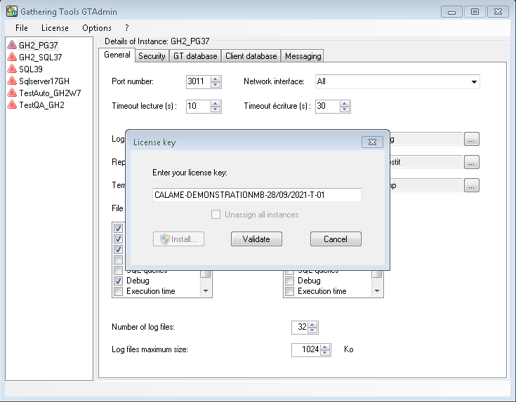
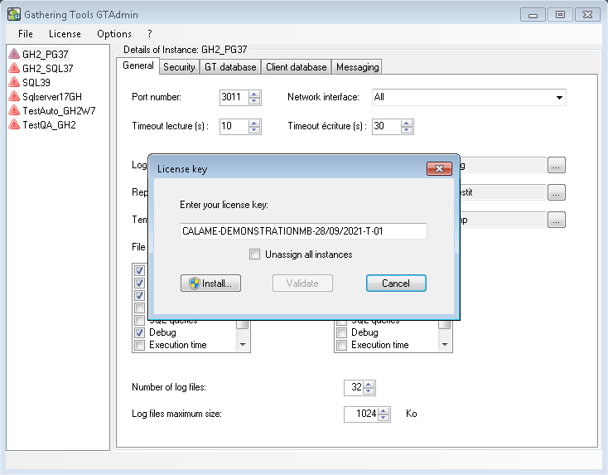
1. AVEC LE BOUTON VALIDER
Enter the new license key Click on the "Validate" button
Then click on "Install"

Slide 8
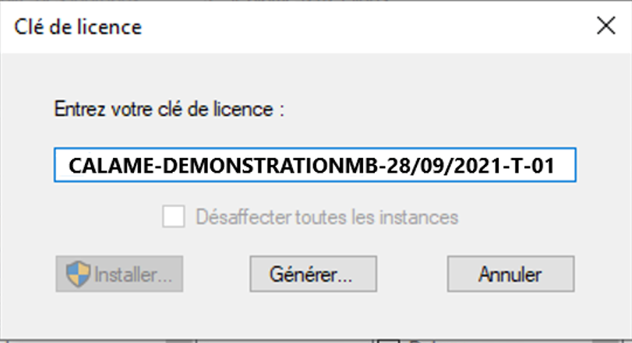
2. SI UN BOUTON GÉNÉRER REMPLACE LE BOUTON VALIDER
Close the dialog box with the message informing of the connection failure. Enter the license key received from support
Click on the "Generate" button
The text proposed in the text box starting with (----- BEGIN GTLIC DATA1 TO SEND ----- ) of the panel is to be sent in an email to the support (support@gathering-tools.com). In return, the support sends you an email containing a new text starting with (----- BEGIN GTLIC DATA2 RECV -----)
The support return text is to be entered in the next panel of the configuration wizard.
Click on the "Validate" button Then continue the installation by clicking the Install button in the previous box requesting the license key

Slide 9
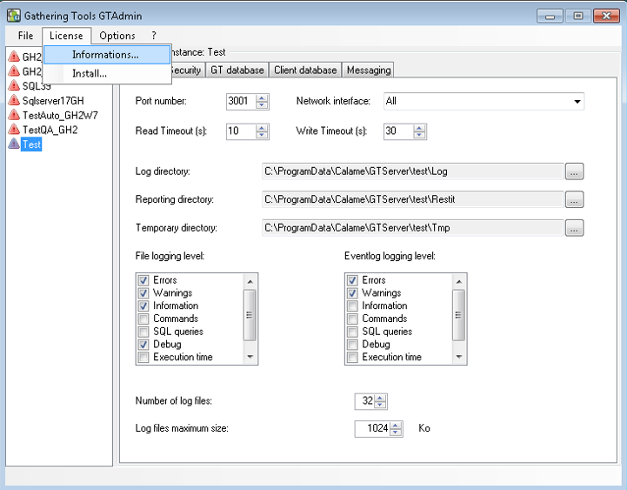
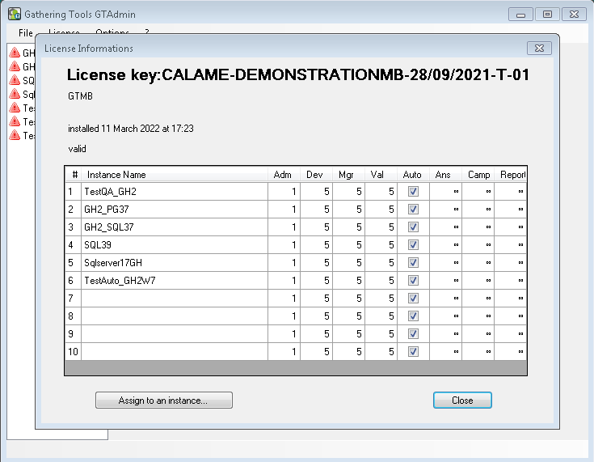
AFFECTER LES INSTANCES
Once the license key is installed, go to the "License/Information..." menu
This box allows you to associate the instances declared in GTAdmin with the instance numbers of the license key and to view the characteristics of each instance license (number of administrators, developers, automation licenses, managers and validators)

Slide 10
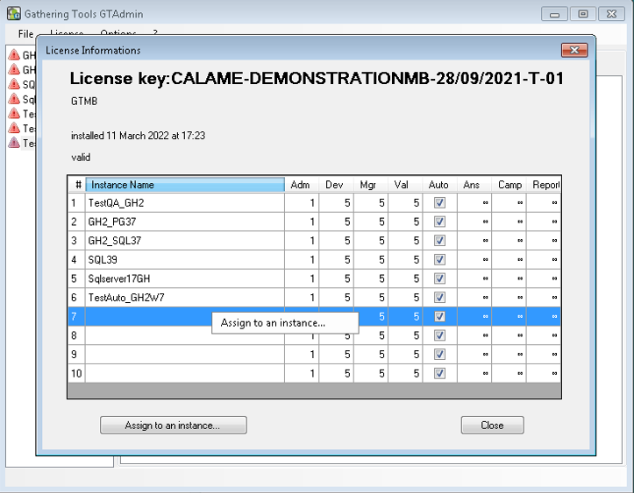
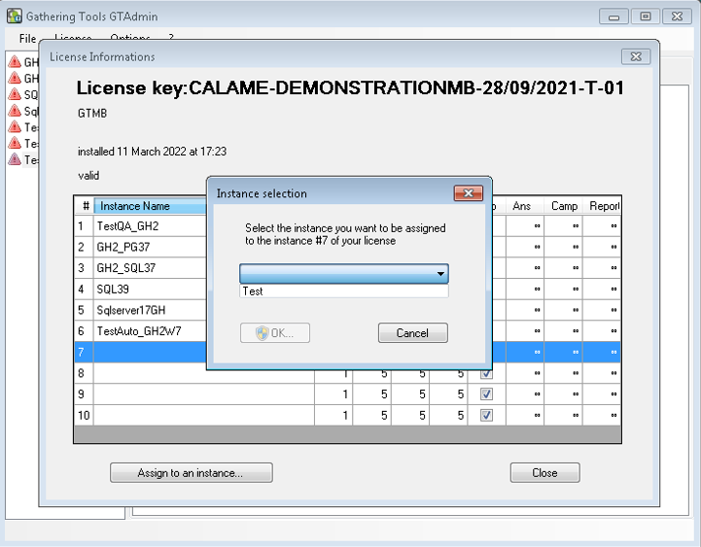
AFFECTER LES INSTANCES
Select an instance number of the key (the line appears in blue)
Assign to an instance
Click on "Assign to an instance...“
A dialog box allows you to assign this key instance number to an instance declared in GTAdmin

Slide 11
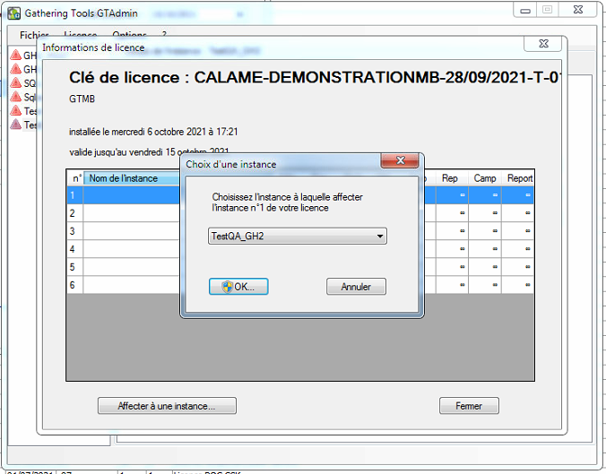
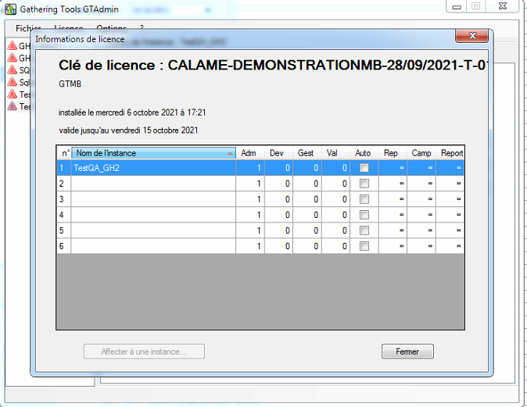
AFFECTER LES INSTANCES
Select the key instance from the drop-down menu
Click on "OK"
Your instance appears in the "Instance Name" field
Click on "Close"

Slide 12
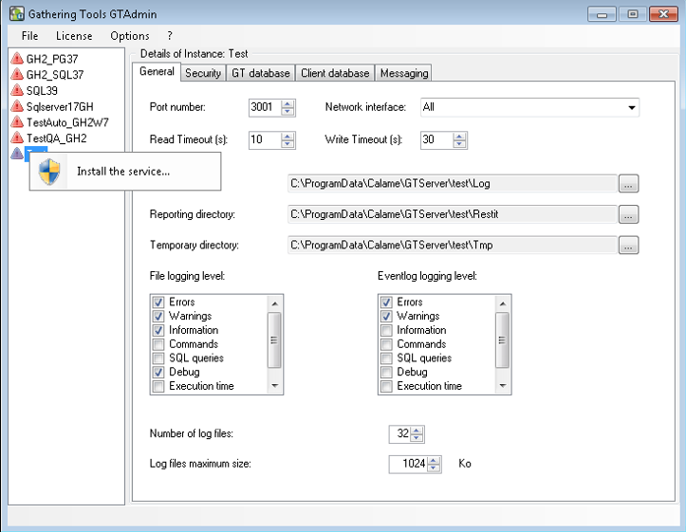
DANS GTADMIN REDÉMARRER L'INSTANCE
Right-click the instance Start the service
The instance is in service (recognizable by its 2 circular green arrows)

